Slide 1
Kings of Dominia
Alexander Schuster, Mengdi Wang ,
Mohamed Haddej, Alexander Epple

Slide 2
Game Overview
Titel: Kings of Dominia
Platform: Android/iOS & Windows
Genre: Puzzle / Strategy
Rating: FSK 0
Target: Casual Gamer
Kings of Dominia is a puzzle game where you place Domino stones strategically in order to bring the enemy to fall. There are mutiple levels and stone types to achieve this goal.

Slide 3
High Concept & Unique Selling Points
High Concept:
Kings of Dominia takes place in a medieval world where the player is in control of a Domino army.
The player tries to storm castles of enemy kings by placing Domino rows and using upgrade stones.
Blast, slide and fall through a variety of levels and bring glory to your kingdom.
Unique Selling Points:
Multiplatform support (Android/iOS/Windows)
Unique concept (modern Domino game)
Easly expandable (free/paid DLCs)

Slide 4
Game Objectives & Game Rules
Goal:
Bring the enemy king to fall by placing Domino rows and using upgrades strategically
Rules:
Place unlimited normal stones on flat surfaces
Upgrade a limited amount of placed stones
Start the attempt knocking over your king
Use cannons and gates by letting a stone fall on the respective activation pad

Slide 5
Game Controls
Turn and move the camera with two fingers
Switch between the view and edit mode by clicking the respective button
Place Domino rows by drawing on the level
Upgrade a Domino by holding down on it
Turn cannons by holding down on them
Start the attempt by clicking on the king
Reload the level and undo an action by clicking the respective buttons

Slide 6
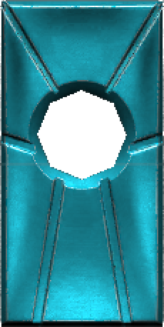
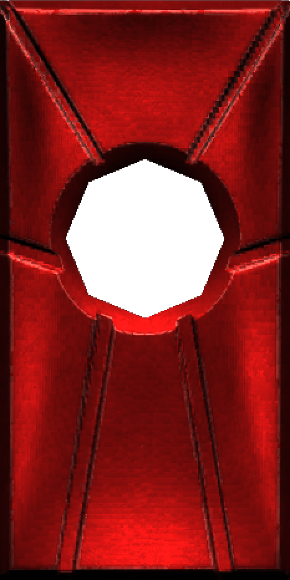
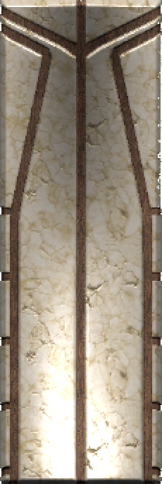
Stone Types
Ice Mage
Pyro
Warrior
Slides once it falls in the falling direction, can pass stairs
Blows up walls that it touches, causes a big shockwave
Can reach farther as well as hit objects like boulders harder

Slide 7

Trailer

